Slide 1
Learning Combinatorial Optimization Algorithms over Graphs
Hanjun Dai*
Joint work with Elias Khalil*, Yuyu Zhang, Bistra Dilkina, Le Song
Georgia Tech
To appear in NIPS 2017
* equal contribution

Slide 2





A motivational example
Minimum Vertex Cover
Find smallest vertex subset S s.t. each edge has at least one end in S
Models advertising optimization in social networks

Slide 3
Motivation
Tackling NP-Hard problems | Design rationale
Exact algorithms | Tight formulations, good IP solvers
Approximation algorithms | Worst-case guarantees
Heuristics | Empirical performance
Can classical algorithms exploit the common distribution of instances?
Not automatically!
A realistic setting
Same problem is solved repeatedly with slightly different data
Delivery truck in Downtown Atlanta:
Daily routing in the same area with slightly different customers
Delivery in same road network with slightly different conditions

Slide 4
Proposal: Learning Greedy Algorithms
Minimum Vertex Cover
2-approx:
greedily add vertices of edge
with max degree sum
Goal: learn a better criterion for greedy solution construction over a graph distribution

Slide 5
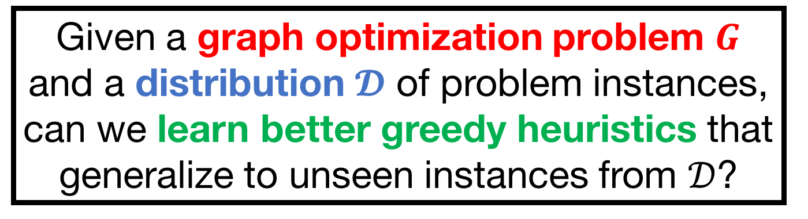
Problem Statement
Given a graph optimization problem $G$ and a distribution $𝓓$ of problem instances, can we learn better greedy heuristics that generalize to unseen instances from $𝒟$?
Minimum Vertex Cover | Maximum Cut | Traveling Salesman Prob.
Insert nodes into cover | Insert nodes into subset | Insert nodes into sub-tour

Slide 6
Challenge #1: How to Learn
Possible approach: Supervised learning
Given a partial solution, predict next vertex to add to solution
Data: collect (partial solution, next vertex) pairs
features label
Task: multi-class classification
Pointer Network[Vinyals, et al., NIPS 2015]: a smarter approach with recurrent neural networks
PROBLEM
Need to compute good/optimal solutions to NP-Hard problems in order to learn!!

Slide 7
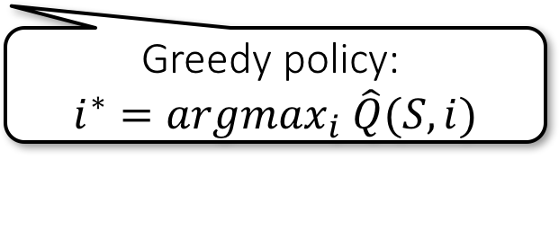
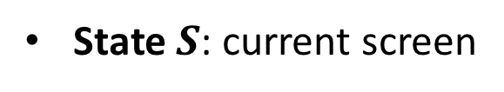
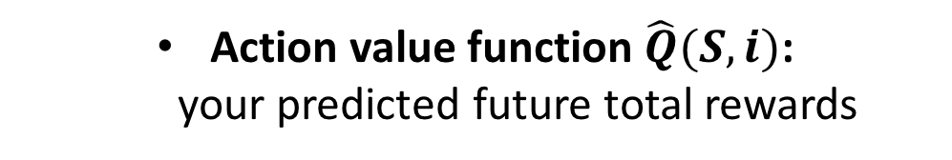
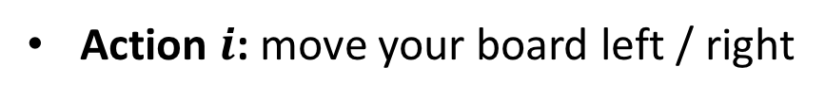
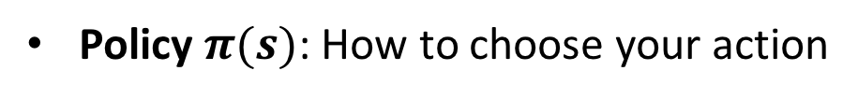
Reinforcement Learning Background
Reward $R(t)$: score you earned at current step
State $S$: current screen
Action $i$: move your board left / right
Action value function $\hat{Q}(S, i)$:
your predicted future total rewards
Policy $π(s)$: How to choose your action
Greedy policy:
$$i^{∗}=argmax_{i} \hat{Q}(S, i)$$
[Minh, et al. Nature 2015]

Slide 8
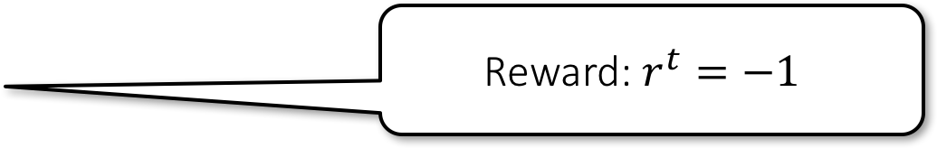
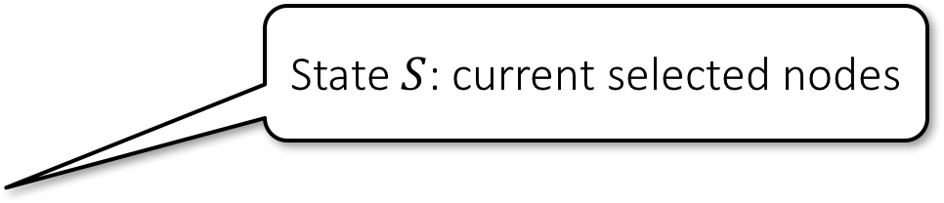
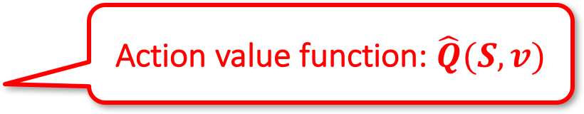
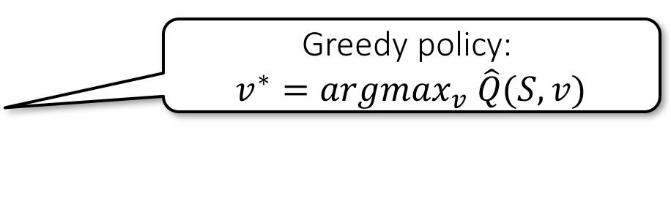

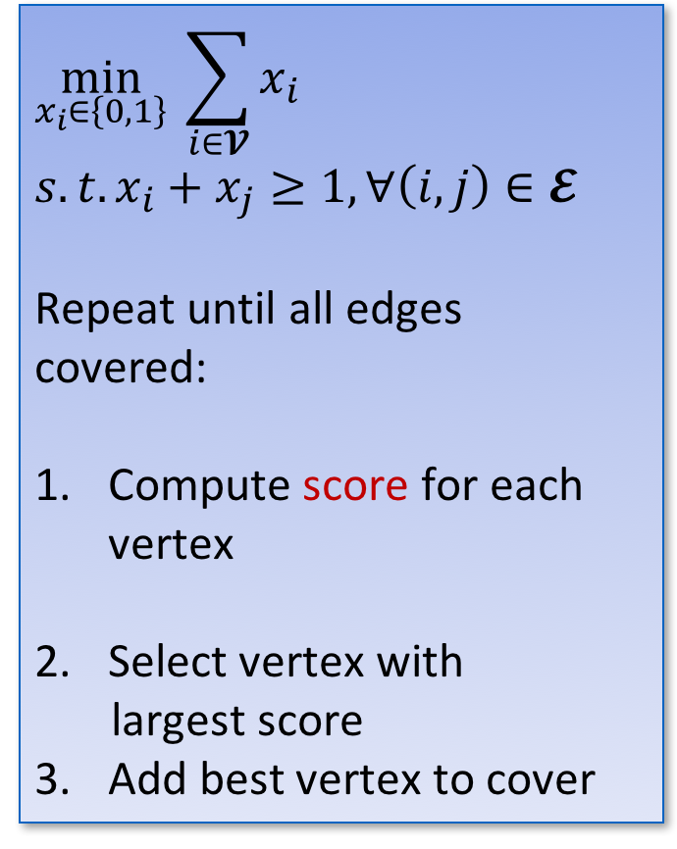
Reinforcement Learning Formulation
$$\min_{x_{i}∈\left\{0,1\right\}} \sum_{i∈𝓥}{x_{i}}$$
$$s.t. x_{i}+x_{j}≥1, ∀\left(i,j\right)∈𝓔$$
Repeat until all edges
covered:
Compute score for each vertex
Select vertex with
largest score
Add best vertex to cover
Reward: $r^{t}=−1$
Minimum Vertex Cover
State $S$: current selected nodes
SOLUTION
Improve policy by learning from experience => no need to compute optima
Action value function: $\hat{Q}(S, v)$
Greedy policy:
$$v^{∗}=argmax_{v} \hat{Q}(S, v)$$
Update state $S$

Slide 9
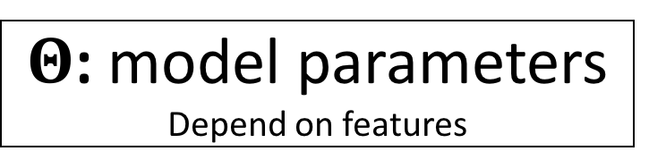
Reinforcement Learning Algorithm
$Θ$: model parameters
Depend on features
Sample graph instance
Explore or
Exploit according to current policy
Update state
Optimize model parameters
Notes:
Link \Theta to features
Add SGD eq

Slide 10
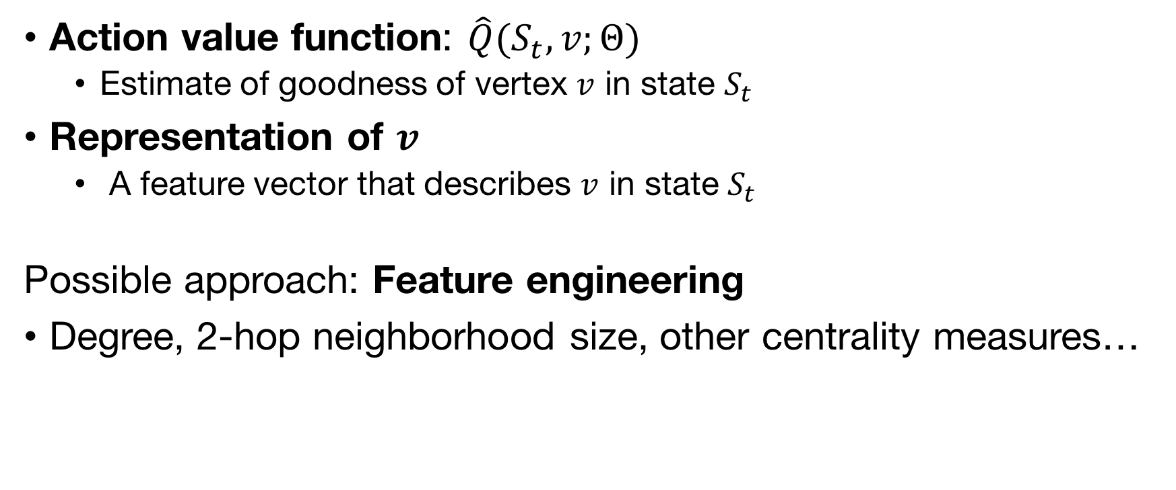
Challenge #2: How to Represent
Action value function: $\hat{Q}(S_{t}, v;Θ)$
Estimate of goodness of vertex $v$ in state $S_{t}$
Representation of $v$
A feature vector that describes $v$ in state $S_{t}$
Possible approach: Feature engineering
Degree, 2-hop neighborhood size, other centrality measures…
PROBLEMS
1- Task-specific engineering needed
2- Hard to tell what is a good feature
3- Difficult to generalize across diff. graph sizes

Slide 11
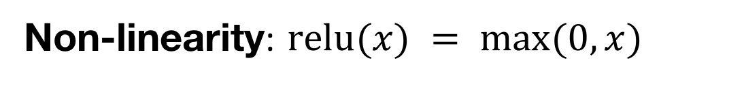
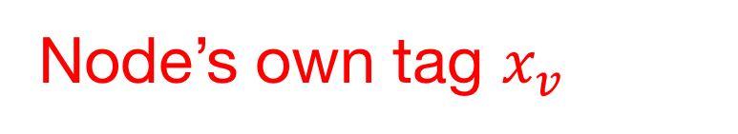
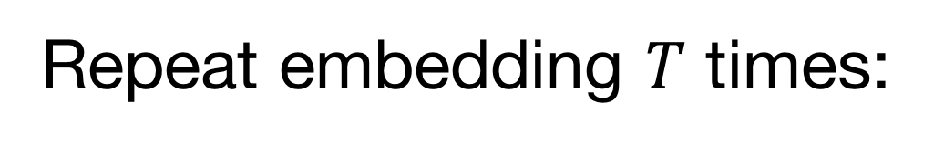
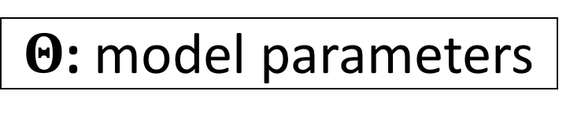

Deep Node Representations
[Dai, et al., ICML 2016]
Repeat embedding $T$ times:
Updating feature vector
1
Node’s own tag $x_{v}$
0
3
Neighbors’ features
$$v$$
1
0
Neighbors’ edge weights
Non-linearity: $\text{relu}(x) = max⁡(0,x)$
$Θ$: model parameters

Slide 12
Deep Node Representations
Repeat embedding $T$ times:
1
For each node:
SOLUTION
1- No feature engineering needed
2- Features’ parameters trained to be good
3- Can handle different graph sizes
Update feature vector
0
3
Compute Q-value:
$$v$$
1
0
Sum-pooling over nodes
Non-linearity: $\text{relu}(x) = max⁡(0,x)$
$Θ$: model parameters

Slide 13
Overall Framework

Slide 14
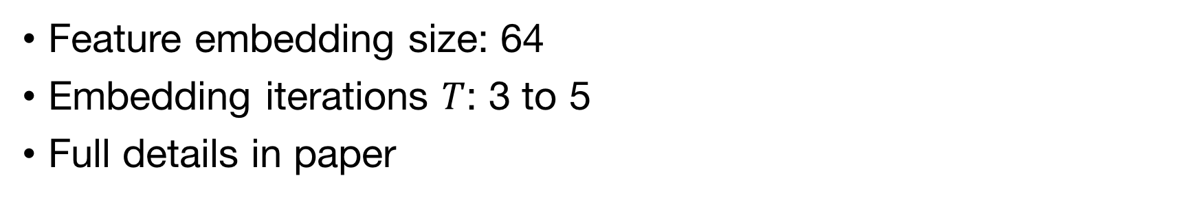
Experimental Setup
 | Minimum Vertex Cover (MVC) | Maximum Cut (MAXCUT) | Traveling Salesman Problem (TSP)
Graph types | Erdos-Renyi (ER) or Barabasi-Albert (BA) | ER or BA | DIMACS generator; uniform grid or clustered
Solvers | ILP with CPLEX | IQP with CPLEX | Concorde
Feature embedding size: 64
Embedding iterations $T$: 3 to 5
Full details in paper

Slide 15
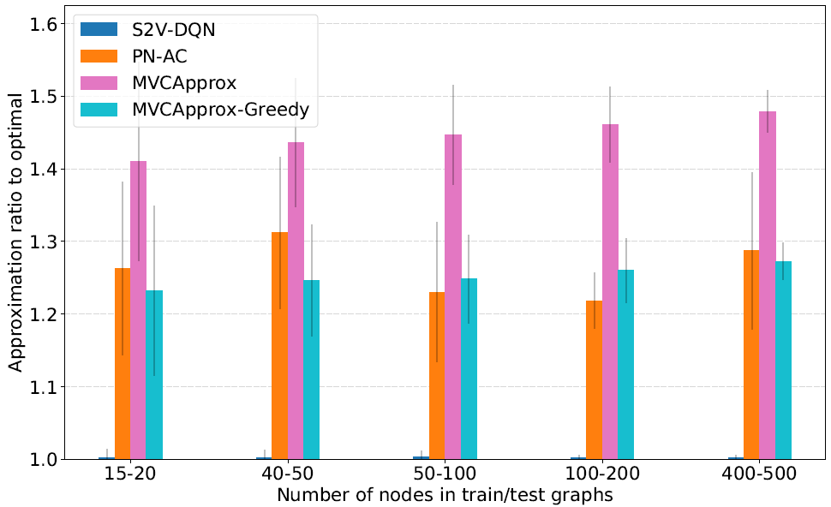

Results: Solution Quality [MVC - BA]
Our method is near-optimal, barely visible.
approximation ratio $≈1$
Notes:
Check size of test set

Slide 16
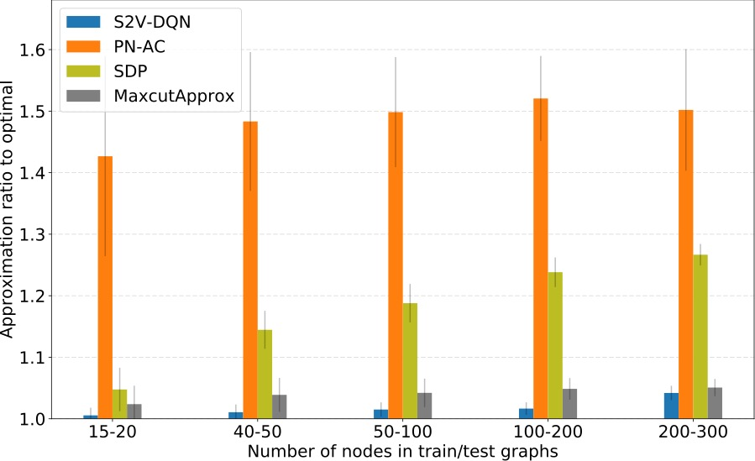
Results: Solution Quality [MAXCUT - BA]

Slide 17
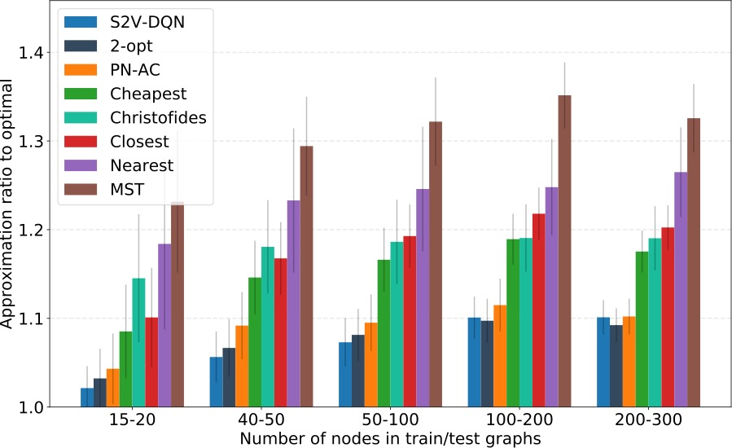
Results: Solution Quality [TSP - clustered]

Slide 18
Results: Realistic Instances
MemeTracker: graph of news propagation between media http://snap.stanford.edu/netinf/#data
Physics: Ising spin glass model http://www.optsicom.es/maxcut/#instances

Slide 19
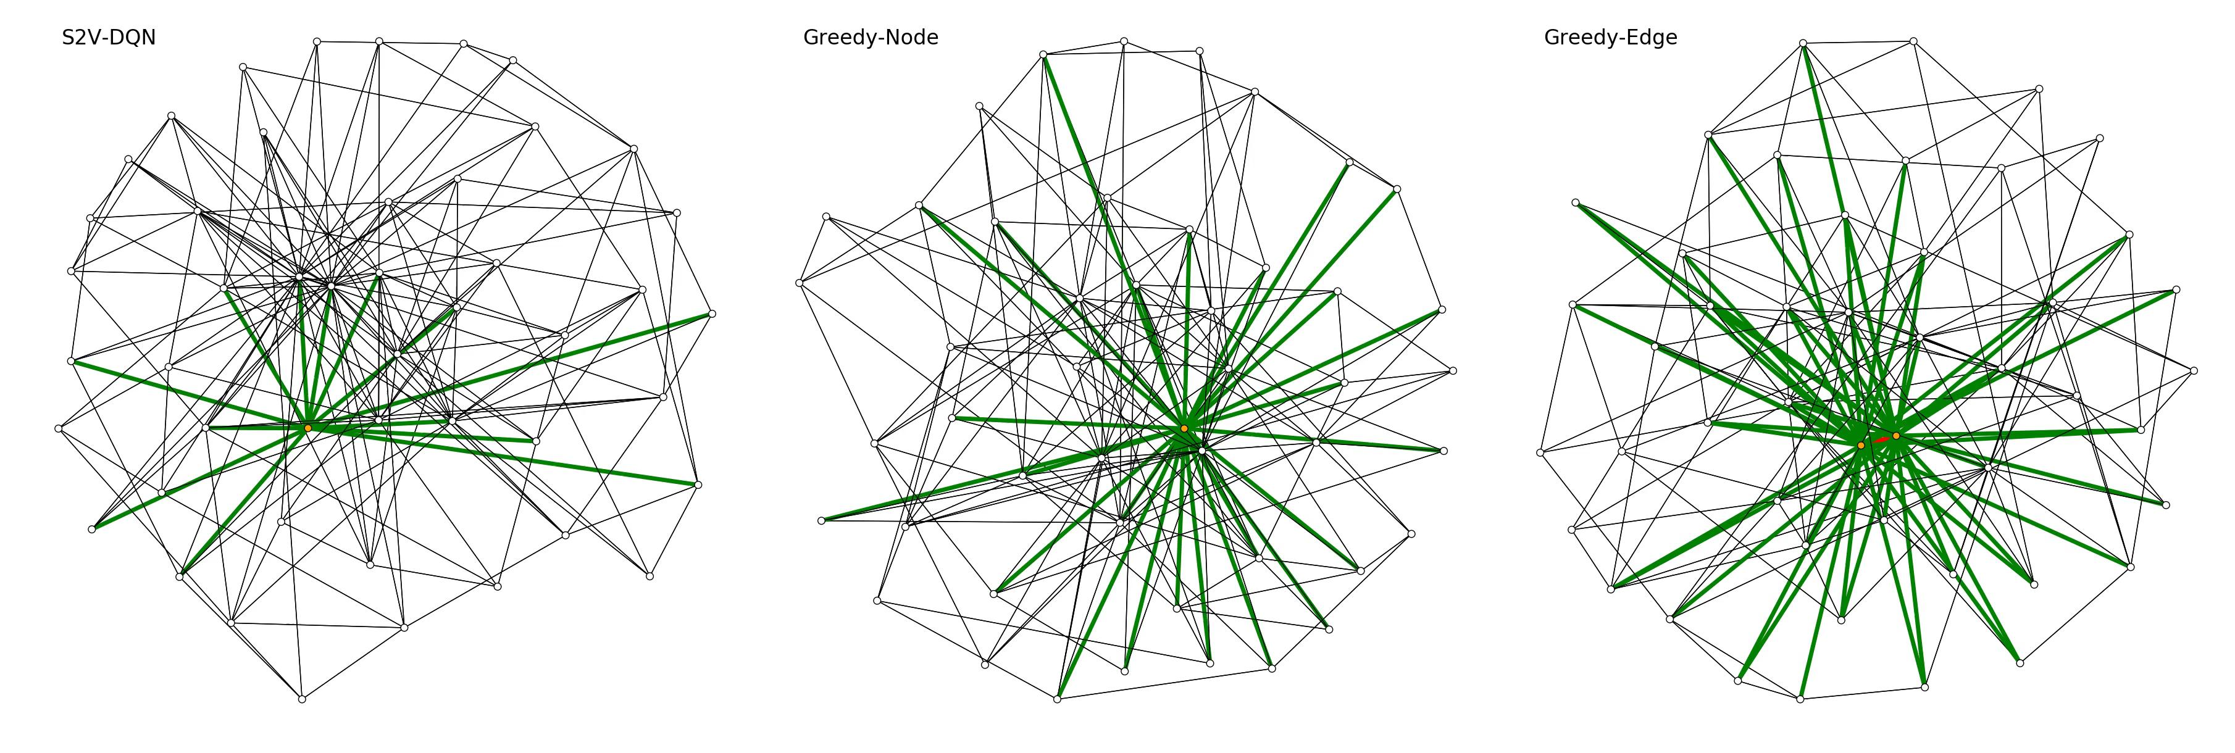
Results: Algorithm Behavior

Slide 20
Results: Algorithm Behavior

Slide 21
Learning graph opt: quantitative comparison
Train on small graphs with
50-100 nodes
Generalize to not only graphs from same distribution
But also larger graphs
Approximation ratio < 1.007

Slide 22
Learning graph opt: time-solution tradeoff
Generate 200 Barabasi-Albert networks with 300 nodes
Let CPLEX produces 1st, 2nd, 3rd, 4th feasible solutions
CPLEX
1st
CPLEX
2nd
Embedding
produces algorithm
with good tradeoff !
2-approx
2-approx +
RNN
CPLEX
3rd
Embedded
MF
CPLEX
4th

Slide 23
Conclusion
A learning framework that exploits graph structure
Applies directly to many graph optimization problems
Promising tool for automated algorithm design
NIPS Preprint: https://arxiv.org/abs/1704.01665
Code: https://github.com/Hanjun-Dai/graph_comb_opt

